Slide 1

Social Determinants
of Health: in Commercial and Medicaid
Adult population (ages 19-64)

Slide 2





Meet Team 2
Akshansh Baliyan
MIS
Chirag Rajendra
MIS
Derek Choppolla
MS BA
Rashmi Balappa
Ujjankop
MIS
Shelby
Chan
PharmD/MBA

Slide 3
Agenda
01
Objective
Demographics
02
Insights
Recommendation
03
04

Slide 4
Agenda
01
Objective
02
Demographics
Insights
Recommendation
03
04

Slide 5
Objective
Total Population
Highest RAF Score
Identifying and addressing the social determinants of health in Commercial and Medicaid patients based on their healthcare utilization.
Place of Service
Zone/SDoH
Disease

Slide 6
Agenda
01
Objective
Demographics
02
Insights
Recommendation
03
04
Notes:
What we learned about the population

Slide 7
Agenda
01
Objective
Demographics
02
Insights
Recommendation
03
04
Notes:
What we learned about the population

Slide 8
16,491
total patients
0.29
442,925
average RAF score
total number of claims

Slide 9
16,491
81.93%
of Commercial patients
18.12%
total patients
of Medicaid patients
0.29
442,925
average RAF score
total number of claims

Slide 10
Agenda
01
Objective
Demographics
02
Insights
Recommendation
03
04

Slide 11
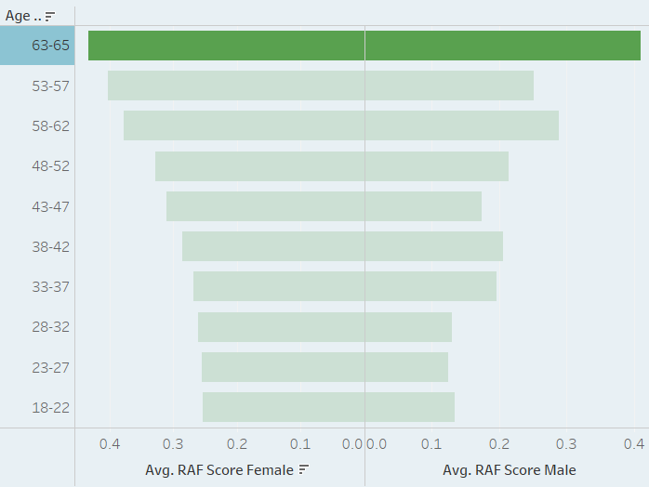
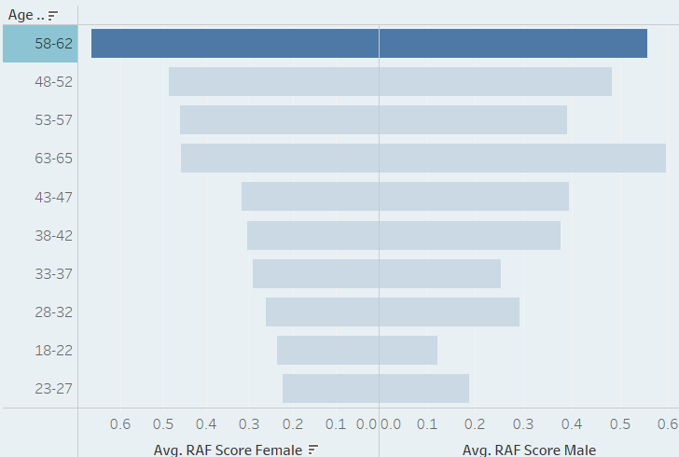

Risk Stratification of Patients
Commercial
Medicaid
0.4335
0.4103
0.662
0.5571

Slide 12
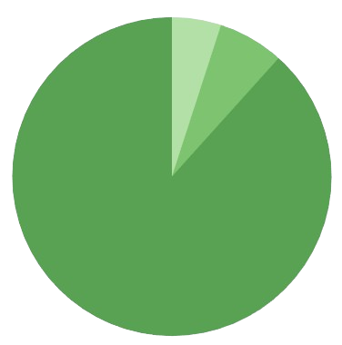
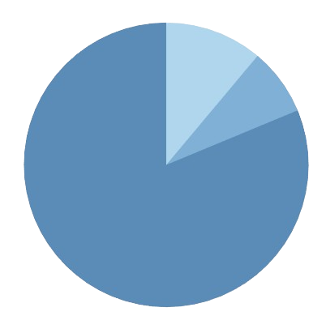
Place of Service in Total Population
Commercial
Medicaid
4.98%
11.09%
Emergent Care
6.68%
Hospitalization
7.64%
88.34%
81.27%
Professional Care

Slide 13
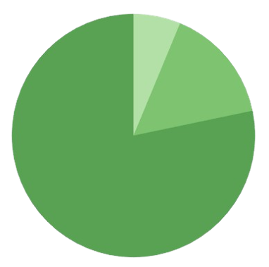
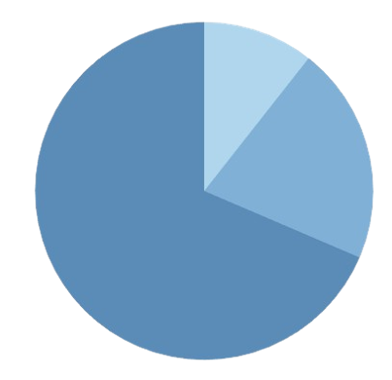
Top 5% Acute Population by Place of Service
Commercial
Medicaid
6.26%
10.6%
Emergent Care
15.46%
20.84%
Hospitalization
78.28%
Professional Care
68.56%

Slide 14
Patients by Income
4,987
$80,000 to $65,001
3,493
$65,000 to $50,001
1,781
1,425
946
745
2,555
$95,000 to $80,001
$110,000 to $95,001
$50,000 to $30,000
$125,000 to $110,001
$140,000 to $125,001

Slide 15
Patients by Income
4,987
$80,000 to $65,001
3,493
$65,000 to $50,001
1,781
1,425
946
745
2,555
$95,000 to $80,001
$110,000 to $95,001
$50,000 to $30,000
$125,000 to $110,001
$140,000 to $125,001
70% lies within
$50k-90k

Slide 16
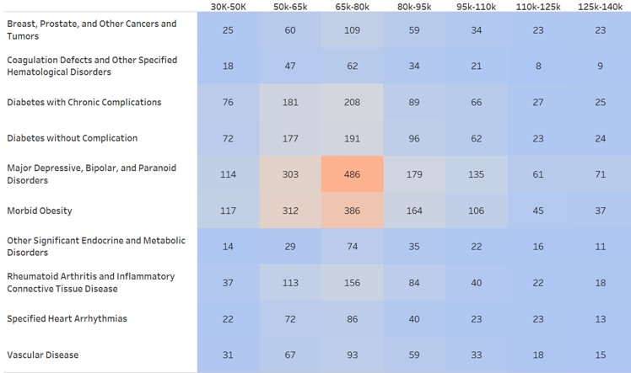
Top 10 Disease based on Income
Big Players: Depression, Diabetes,
and Obesity
Commercial
claims
Medicaid
Claims
Notes:
Now, when we pair up diseases with income levels, some interesting patterns pop up. Depression, Diabetes, and Obesity are the big players, racking up the most patients.

Slide 17
Zones Identified with Highest Utilization
Zone | Air Pollution | Food | Housing Cost | Life Expectancy | Mean Income | Median Income | RAF Score | Smoking
5 | 8 | 8 | 0.1 | 77 | $65,500 | $52,500 | 0.29 | 0.2
6 | 7 | 8 | 0.1 | 78 | $105,500 | $78,000 | 0.26 | 0.2
12 | 7 | 8 | 0.1 | 78 | $62,500 | $53,000 | 0.33 | 0.2
16 | 8 | 8 | 0.1 | 77 | $73,500 | $57,500 | 0.27 | 0.2
22 | 7 | 8 | 0.1 | 78 | $43,000 | $33,500 | 0.51 | 0.2
Commercial
Zone | Air Pollution | Food | Housing Cost | Life Expectancy | Mean Income | Median Income | RAF Score | Smoking
8 | 7 | 8 | 0.1 | 78 | $83,000 | $66,000 | 0.31 | 0.2
14 | 7 | 8 | 0.1 | 78 | $64,000 | $51,500 | 0.29 | 0.2
21 | 7 | 8 | 0.1 | 78 | $88,000 | $77,500 | 0.27 | 0.2
22 | 7 | 8 | 0.1 | 78 | $43,000 | $33,500 | 0.51 | 0.2
59 | 7 | 8 | 0.1 | 78 | $46,000 | $36,500 | 0.47 | 0.2
Medicaid
Notes:
Moving on to geography, we've pinpointed the Top 5 Zones based on claim numbers. These are our hotspots and knowing them helps us focus our efforts where they matter most – and these zones will guide our targeted interventions.

Slide 18
Major Disease Conditions in Top 5% Acute Population
Commercial
Medicaid
Diabetes without Complication
Major Depression, Bipolar & Paranoid Disorder
Morbid Obesity
Diabetes with Chronic Complication
Major Depression, Bipolar & Paranoid Disorder
Other Significant Endocrine & Metabolic Disorder
56%
65%
Claims Account for
Top 3 Diseases -
Commercial
Claims Account for Top 3 Diseases - Medicaid
Notes:
Zooming in for the top 5 zones, we discover a significant insight. Approximately 56% of claims in the commercial population and 65% in Medicaid stem from just three diseases: Diabetes, Morbid Obesity, and Depression for Commercial, and Diabetes, Metabolic Disorders, and Depression for Medicaid. These insights pinpoint where our efforts can make the most impact.

Slide 19
Hospital Utilization based on Income
Commercial
Medicaid
12% of $50-65K
Visits from Hospitalization
40% of $65-80K
Visits from Hospitalization
 | $30-50K | $50-65K | $65-80K | $95-100K |  | $30-50K | $50-65K | $65-80K | $95-100K
Emergent Care | 22 | 249 | 140 | 118 |  | 22 | 10 | 133
Hospitalization | 255 | 416 | 498 | 150 |  | 112 |  | 627
Professional Care | 707 | 2,801 | 2,305 | 1,384 |  | 362 | 151 | 826
Notes:
Now, let's talk about outcomes. In the $50,000 to $65,000 income bracket, about 12% of visits lead to hospital stays for our commercial friends. Jumping up to the $80,000 to $95,000 range, that number skyrockets to 40%. Understanding these numbers helps us figure out how to keep folks healthier without resorting to hospital stays.

Slide 20
Hospital Utilization based on Age
Commercial
Medicaid
16%
of Hospitalization visits are from Ages 58-62
56%
of Hospitalization visits from ages 53-57
 | 18-22 | 23-27 | 28-32 | 33-37 | 38-42 | 43-47 | 48-52 | 53-57 | 58-62 | 63-65
Emergent Care |  | 5 |  | 1 | 53 | 90 | 75 | 61 | 180 | 64
Hospitalization | 6 | 6 |  | 29 | 40 | 75 | 348 | 154 | 446 | 215
Professional Care | 114 | 202 | 44 | 291 | 434 | 428 | 637 | 1,477 | 2,206 | 1,364
28-32 | 33-37 | 43-47 | 48-52 | 53-57 | 58-62 | 63-65
 | 1 | 14 | 32 | 95 | 10 | 13
 | 25 | 5 | 115 | 485 | 4 | 106
24 | 74 | 199 | 242 | 275 | 286 | 239
Notes:
Lastly, age becomes a critical factor. In the 58-62 age bracket, 16% of visits result in hospitalizations in the commercial population. Contrastingly, in the 53-57 age bracket for Medicaid, a striking 56% of visits lead to hospitalizations. Tailoring our strategies based on these age-specific patterns will be key to reducing hospitalizations.
In conclusion, our journey from income distribution to disease insights, geographical considerations, and nuanced breakdowns by income and age brackets has unveiled actionable opportunities. To achieve our goal of reducing hospitalizations, we'll be focusing on targeted interventions in the identified zones and tailoring our approach to the specific needs of income and age groups. By addressing social determinants and aligning our strategies with these findings, we can make significant strides in improving health outcomes for our community. By doing so, we're not just reducing hospital stays; we're elevating population health, improving the patient experience, and working towards cost-effective healthcare

Slide 21
Agenda
01
Objective
Demographics
02
Insights
Recommendation
03
04

Slide 22
Diabetes Recommendation
Approximately 35% of Americans (88 million adults) have been diagnosed with prediabetes¹
Demographics:
Target Audience: 18-30
Demographics:
Target Audience: Individuals aged 30+
Recommendations:
Educate
Highlight the increasing prevalence of diabetes among young adults due to lifestyle factors.
Utilize data on rising diabetes rates to emphasize the need for proactive interventions by making them envision the life of a diabetic patient.
Programs
Incorporate healthcare awareness programs right from schools and colleges, this will help reduce costs in the longer run.
Collaborate with universities to host workshops on healthy living and diabetes prevention.
Recommendations:
Educate
Highlight the conditions which they might face and the proper places to visit to get help.
Utilize data on rising diabetes rates to emphasize the need for proactive interventions by making them envision the life of a diabetic patient.
Telehealth Services:
Offer telehealth services for remote consultations with healthcare professionals.
Medication management and virtual check-ins to ensure regular monitoring.
The Value Transformation Framework: Applied to Diabetes Control in Federally Qualified Health Centers - PMC (NIH.GOV)
Notes:
Create a team of care coordinators and case managers to serve patients physical and behavioral health and social needs.

Slide 23



Recommendation
Create a team to address SDoH
Care coordinators, case managers, community health worker, nutritionist
Standardized screening and outcome results
Notes:
Create a team of care coordinators and case managers to serve patients physical and behavioral health and social needs.

Slide 24
Address all SDoH Factors
Education Access
Do you understand what your medication is for?
Health Care Access
Did you feel like all of you needs were met?
Economic Access
Are you having trouble affording your medication?
Neighborhood
and Built Environment
How do you feel walking around your neighborhood?
Social
and Community Context
Do you have a support system?
Notes:
Tailor program to number #1 disease state which is diabetes? Here is how a team would look like addressing the needs of a diabetic patient
Manufactors program that cap insulin at $35

Slide 25

Improve experience and population heatlh
Per Capita Cost
Experience of Care
Population health

Slide 26
Recommendation
Thank You
What questions do you have?

Slide 27
Potential Sources of Income
"Start Small and Expand" Model
Patient-Centered Reimbursement System: Fee-for-service Criteria + Value-based care criteria
MCO, Medicaid, Medicare, Government-sponsored public health initiatives, Charitable foundation
Local
County
Region

Slide 28



Educating Pre-diabetic and Diabetic Patients
Diabetes Self-Management Education and Support (DSMEs)
National Diabetes Prevention Program (National DPP)

Slide 29

CPESN Care Model - SDoH
Community pharmacy enhanced service network (CPESN)
Clinically integrated network of community pharmacies that coordinates patient care with broader care teams

